Slide 2
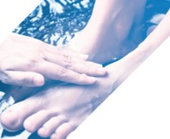
Outline
Your experience
Story of Faithful Stewards
Exploring the text
Checking the recommendations
Prayer

Slide 3
Your experience and hopes
What brought you to this gathering?
When have you been able to contribute your parish (or faith community)?
When have you felt neglected or silenced?
What do want the Church to be or do for the next generation?
What do you hope to see in your lifetime?

Slide 4
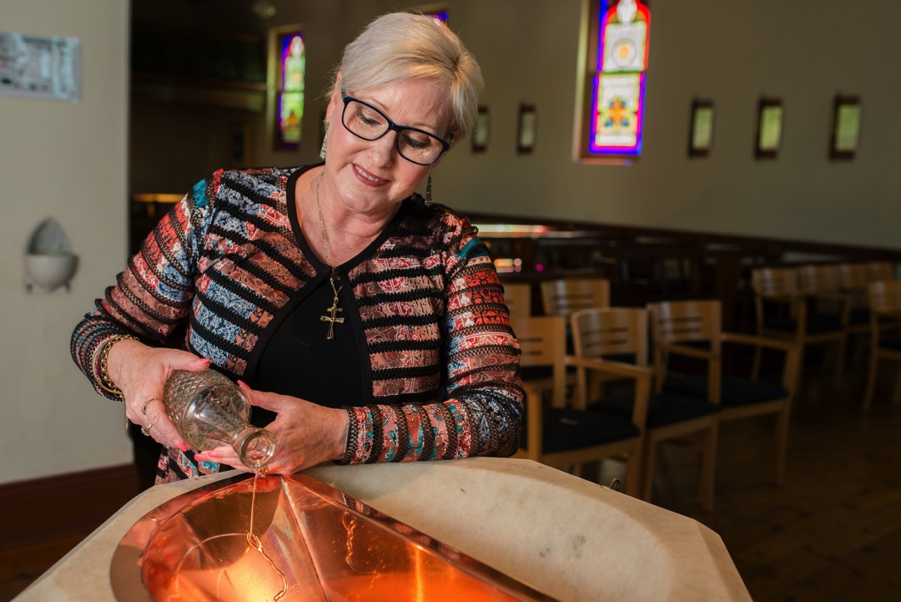
There are so many needs,
pastorally and sacramentally.

Slide 5
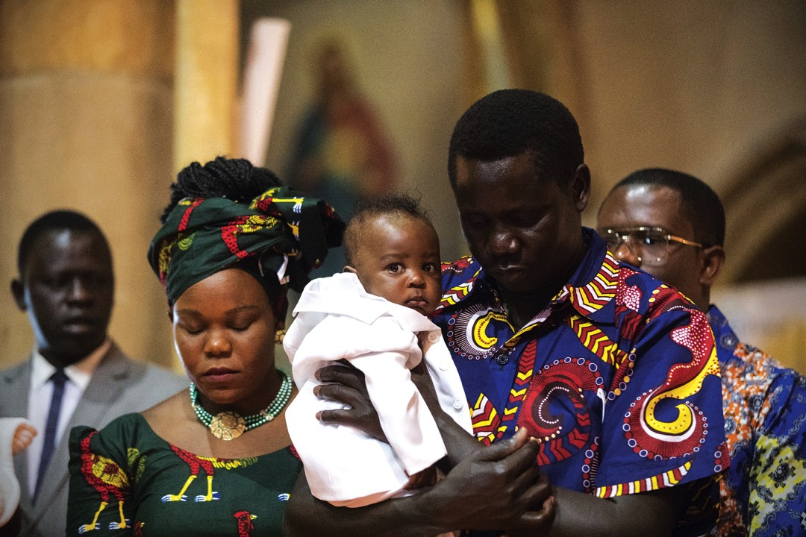
We have to be involved,
otherwise we wouldn’t have a Church.
We are Church.

Slide 6
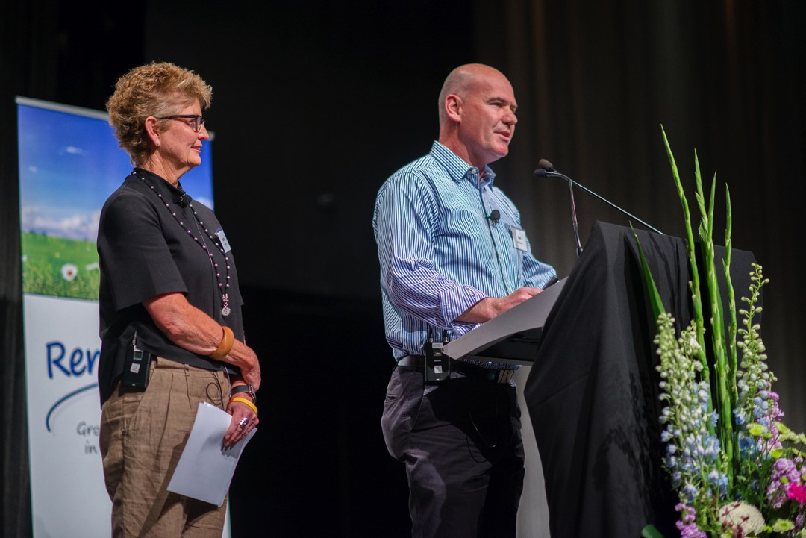
I get energised from it.
I find these are moments of grace.
The Spirit is moving in my life and I’m responding,
doing the best I can.

Slide 7
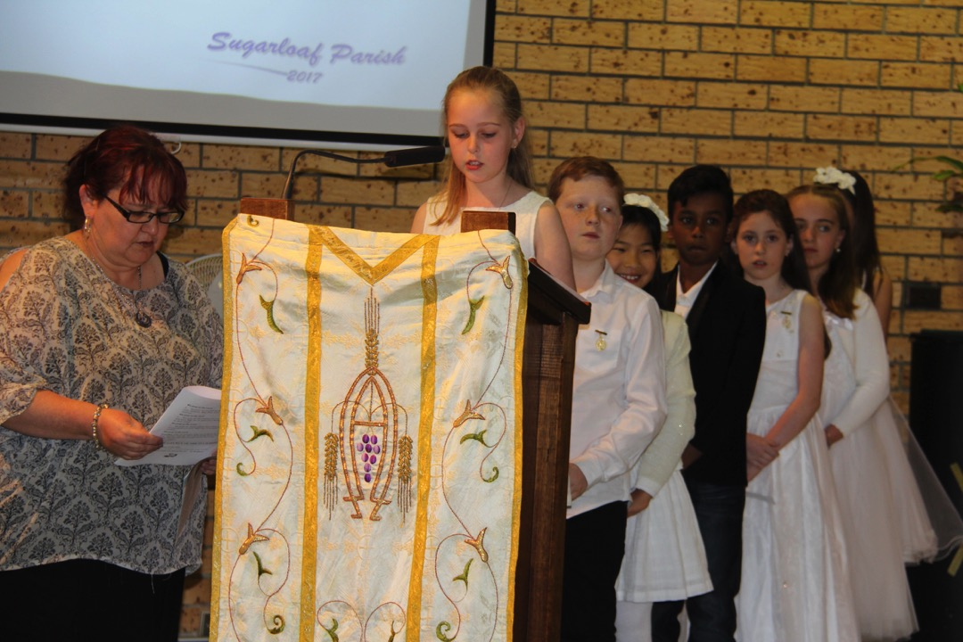
As a pastoral associate I’m a co-worker
with the parish priest.
That’s a new recognition,
me being a co-leader too.

Slide 8
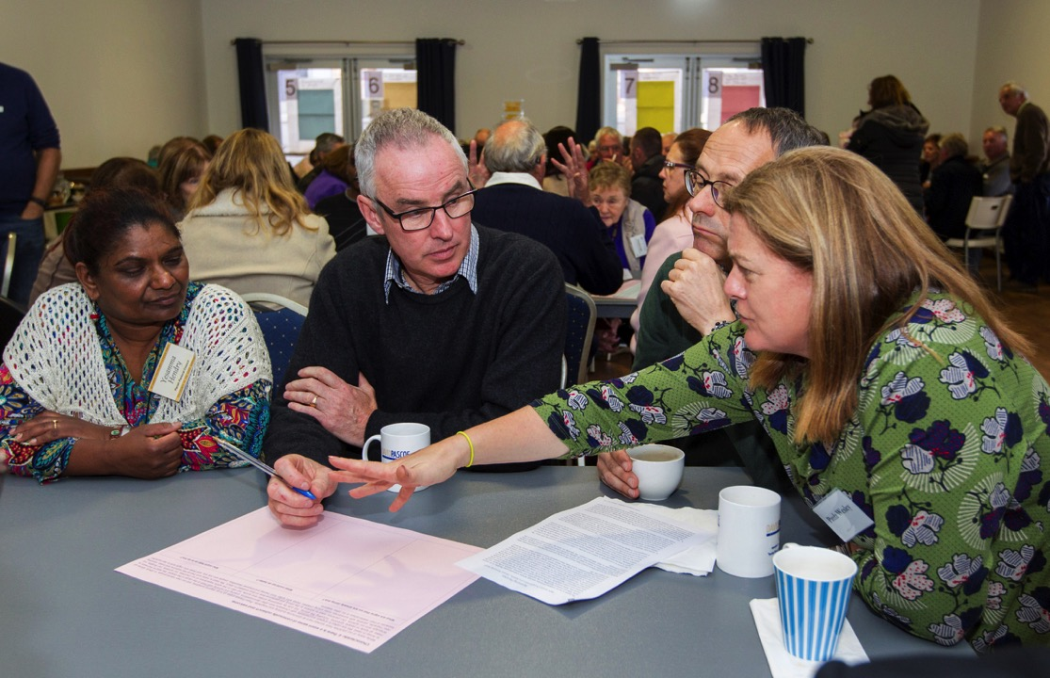
There are difficult moments, when we test each other’s patience … its important to spend time together as a team, help each other, encourage each other, learn from each other.

Slide 9
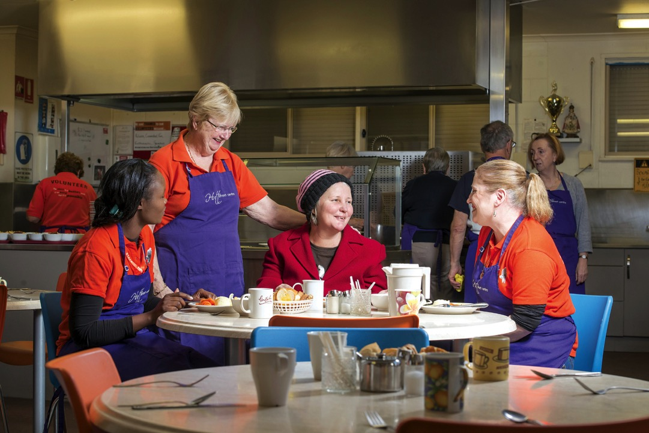
I like to think that every interaction
I have with people is
‘the face of the Church’.

Slide 10
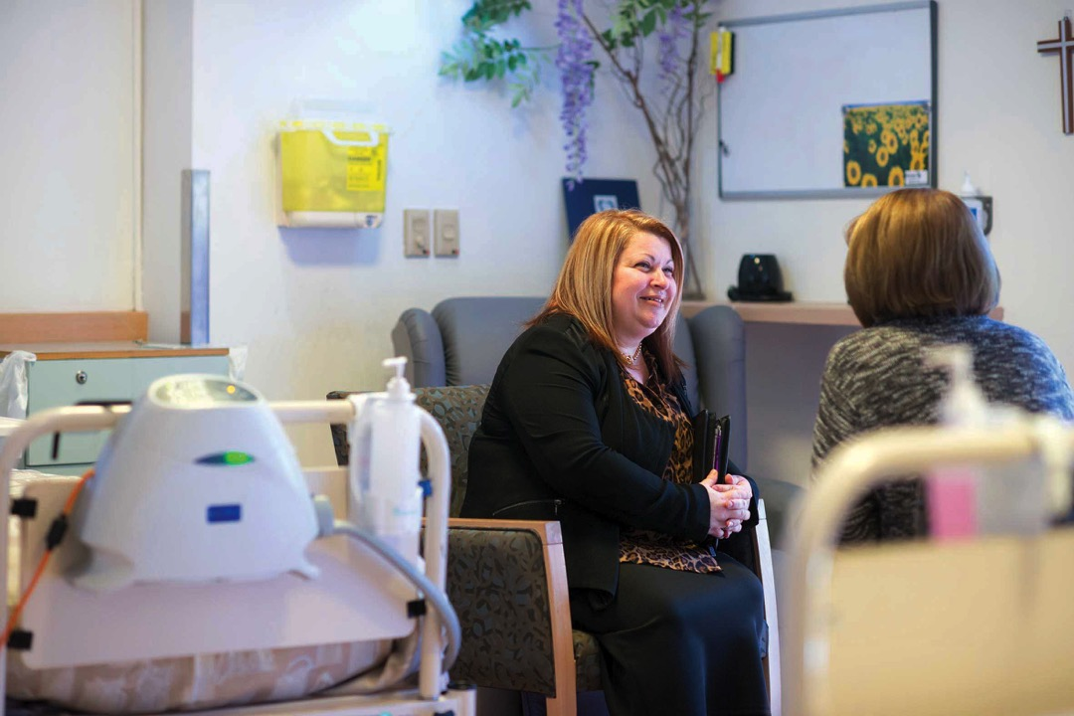
This is my career. This is my job.
I am a professional … representing the parish …
it isn’t all ‘fun and games’!

Slide 11
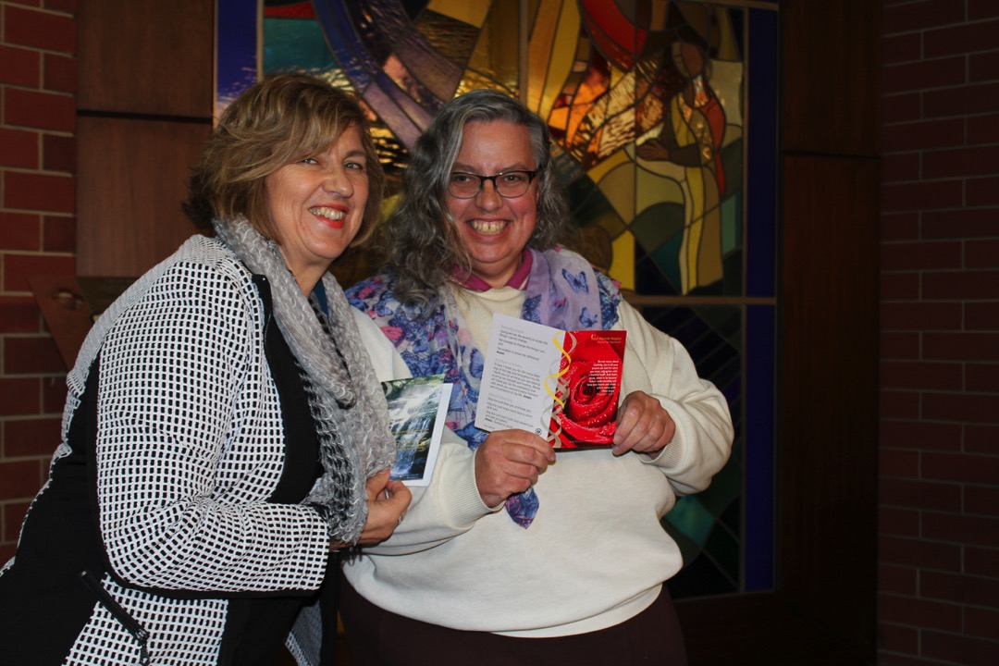
Ministry is part of the
nature of baptism.
It’s who and what we are.

Slide 12
Imagine …
What else might have emerged in the research into lay pastoral ministry in Australia?

Slide 13
How it is and has been
Where there is tension
Solid ground
Getting real
Pointers
5. Recommendations
4. The Practice of Lay Pastoral Ministry
3. Theology of Lay Pastoral Ministry
2. A Complex Landscape
1. Past and Present Reality

Slide 14
Examine a chapter

Slide 15
1. Past and present reality
1.1 Lay involvement in the mission of the Church
1.2 Renewal of ministries
1.3 Present diversity
..\Faithful Stewards Launch\RENDER catholic preview 3.mp4

Slide 16
2. A Complex Landscape
2.1 Understanding the terminology
2.2 Understanding complementarity of ministries
2.3 Lay Pastoral Ministry and Working Life
2.4 Professionalism and Attitudinal Change

Slide 17
3. Theology of Lay Pastoral Ministry
3.1 Communion and Mission
3.2 Christian Vocation of Discipleship
3.3 Vocation to Ministry
3.4 Lay Pastoral Ministry

Slide 18
4. The Practice of Lay Pastoral Ministry
4.1 Seeking a common vision
4.2 Discernment and formation
4.3 Authorisation: Certification and Appointment

Slide 19
RECOMMENDATIONS

Slide 20
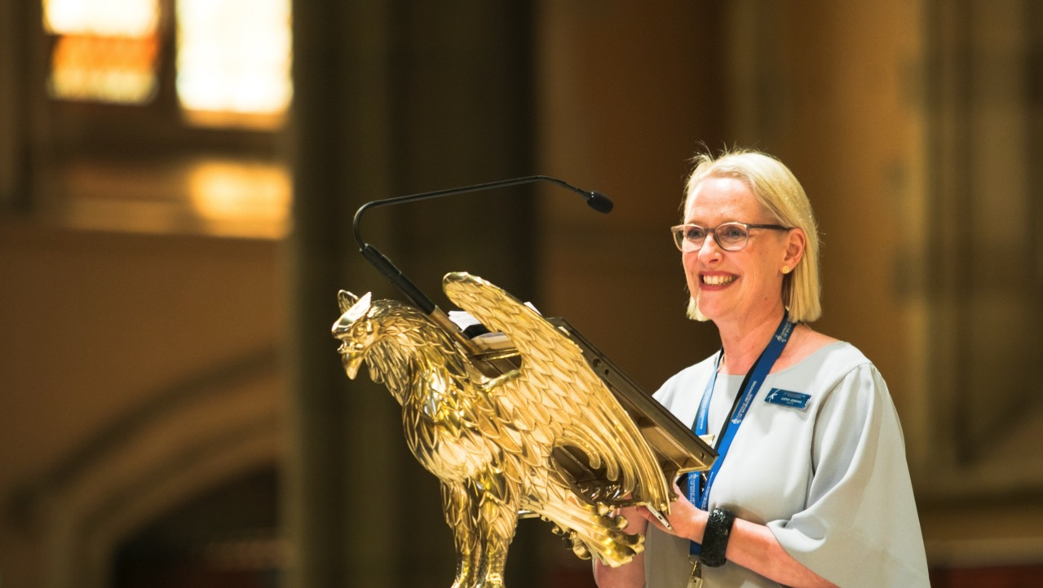
AFFIRM AND CELEBRATE LAY PASTORAL MINISTRY

Slide 21
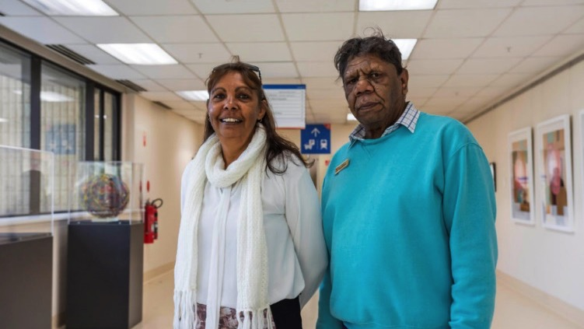
DEVELOP FORMAL STRUCTURES
TO SUPPORT THE WORK OF
LAY PASTORAL MINISTERS

Slide 22
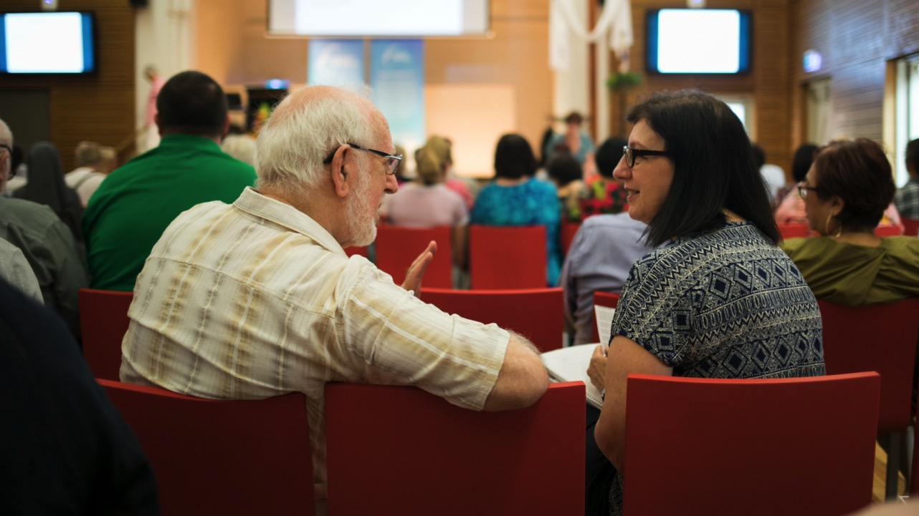
IMPLEMENT BEST PRACTICES
IN RELATION TO
LAY PASTORAL MINISTERS AND VOLUNTEER WORKERS

Slide 23
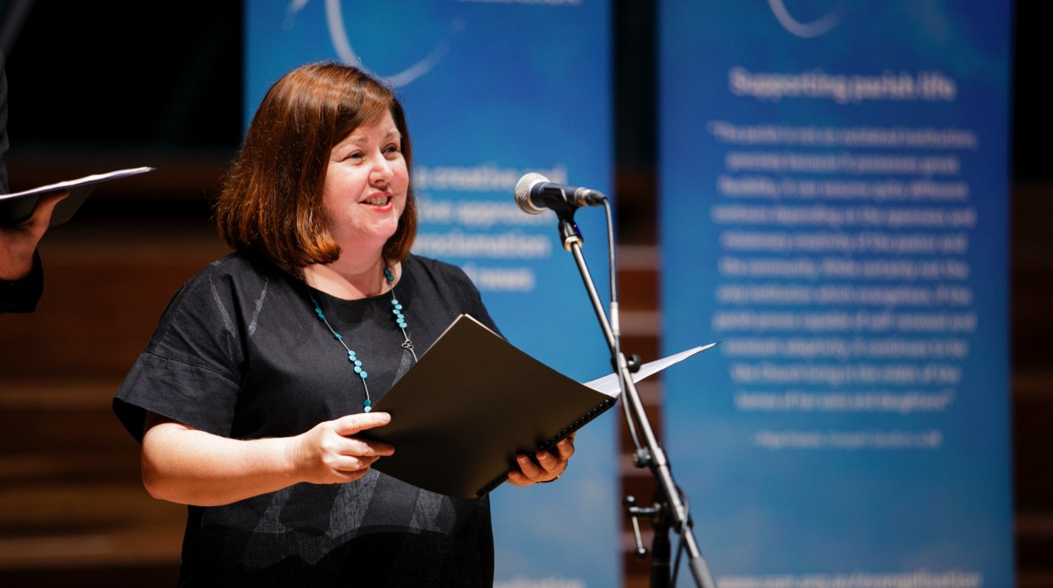
STRENGTHEN FORMATION
AND TRAINING FOR
LAY PASTORAL MINISTERS

Slide 24
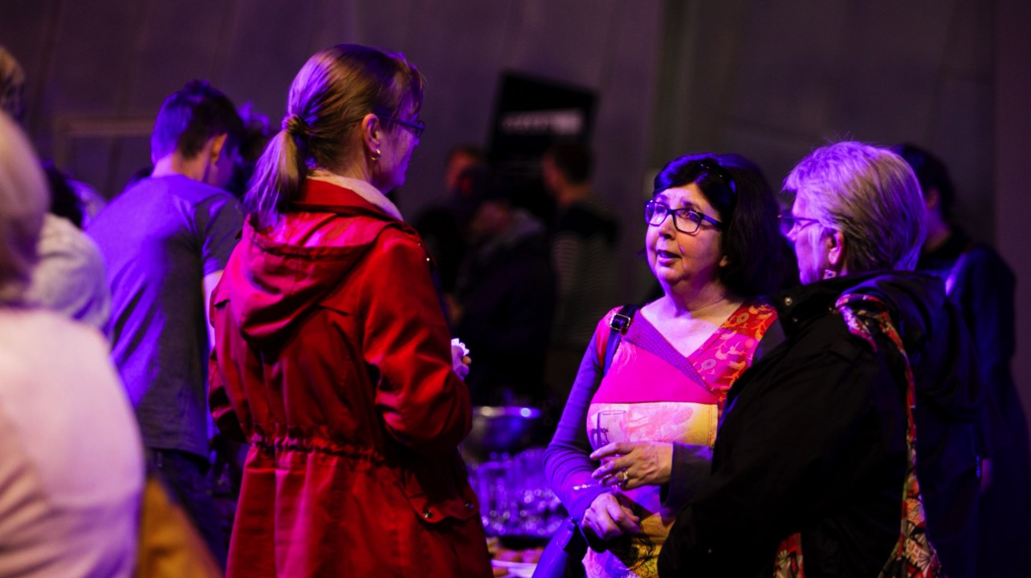
BUILD NETWORKS AND
SHARE RESOURCES.

Slide 25
Review the Recommendations
What strengths? Where would you give them a 
What weaknesses? Where would give a –
What concerns or questions do you have…?

Slide 26
Opening Prayer
Come now, God, and send your Spirit among us,
stir for us this water of memory and imagination.
Send your Spirit to enliven our praise, to strengthen our hands,
to guide us in work and play, in service and love,
to assure us once more and again of your love. Amen.

Slide 27
Gospel (Mk 1:9-11)
In those days, Jesus came from Nazareth of Galilee and was baptized by John in the Jordan. And just as he was coming up out of the water, he saw the heavens torn apart and the Spirit descending like a dove on him. And a voice came from heaven, “You are my Son, the Beloved; with you I am well pleased.”
The Gospel of the Lord.
Praise to you Lord Jesus Christ.

Slide 28
Personal Reflection
What new insights does this commentary offer you?
How do you describe what baptism means to you?

Slide 29
Ritual
Place your hands in the water.
Touch your forehead or face with the water of life—
remembering that you belong to God and you are beloved.

Slide 30
Closing Prayer
Eternal God, you have come to us in Jesus Christ,
given us a new birth by water and the Holy Spirit,
and forgiven all our sins,
bless us now with the grace we need to live as disciples.
Keep us faithful to our Saviour Jesus Christ,
forever and ever. Amen.

