Slide 1
Sharing the Good News, Creating Culture
Mission in Context
MOHMV Conference 2019
Sydney, 13th May 2019
Paul Tighe, Pontifical Council for Culture

Slide 2
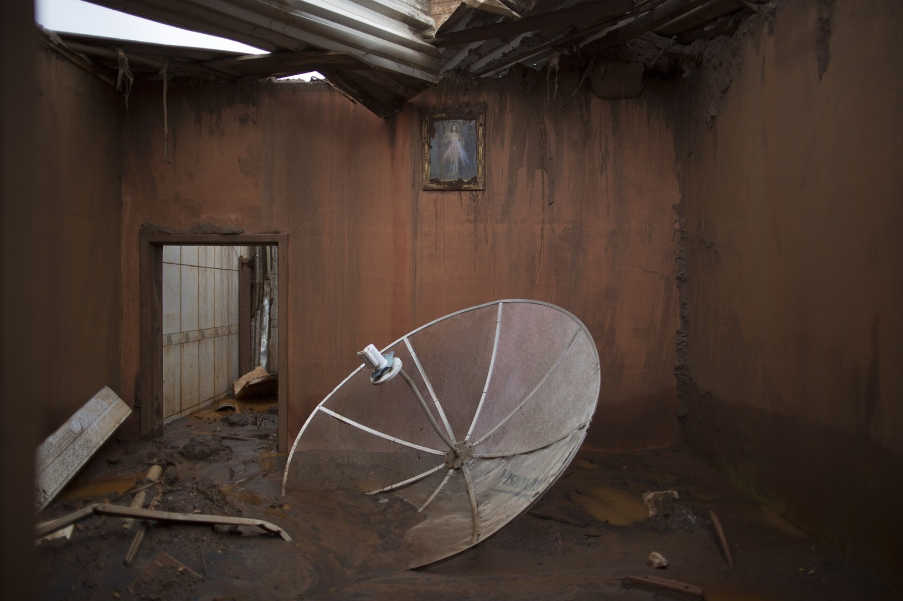
Mission in Context

Slide 3
Church: Identity and Ministry
Mission – bring Good News to ends of the earth
Message – person, relationship and community
Internal – constitutive ecclesial activity, community
Expression (body language) – identity and profile
Explicit attention – never more urgent
Communication – information and relationships
Social media – reinforces relational dimension
Peripheries – physical, social and existential
Culture - digital

Slide 4

Digital World

Slide 5
Digital World
Revolution/Transformation – cultural, change in communications, on-going
Involved – identity, nature and dynamics of belonging
Digital is real – avoid dualism, recognise centrality
Integrated – blended, augmented, existential environment
Digital is different – new, ‘continent’, language and culture
Ecosystem – network, beyond instruments and use
Right question
Presence – absence, effective (@pontifex)

Slide 6
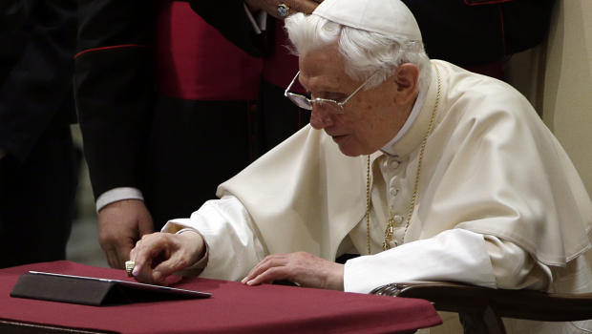
Presence: Shaping the Culture

Slide 7
Presence: Shaping the Culture
Citizens and Believers – building culture
Listen, converse and encourage (isolation)
Neighbour – mercy, tenderness, Good Samaritan
No ulterior purpose – fellow pilgrims, gratuity (selling)
Giving a soul – depth, vulnerability (performance)
Sharing source of hope – faith, gift, conviction
Witness – authenticity, profile, influencer (not bombarding)
Time to speak – time to let love speak (Deus caritas est, 31)

Slide 8
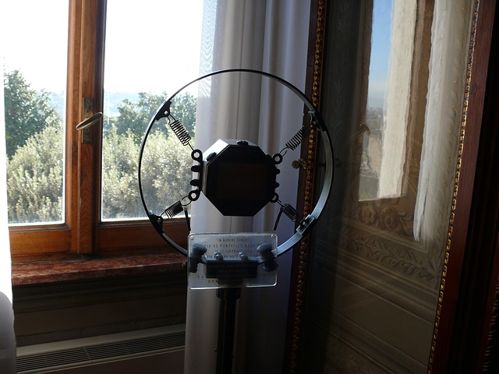
Language: Cultural Fluency

Slide 9
Language: Speaking Digital
Style – conversational, participative, engagement
Institutional challenge – subsidiarity, devolved interactivity (glocal)
Modes – beyond text, multimedia (beauty), warming hearts
Show rather than tell – experience of living (Stained Glass - Facebook, Youtube, apps)
Vocabulary – words, icons, rituals (grammar of simplicity)
Public debate – broadcasting, first language
Vision, values and norms – Yes before No

Slide 10
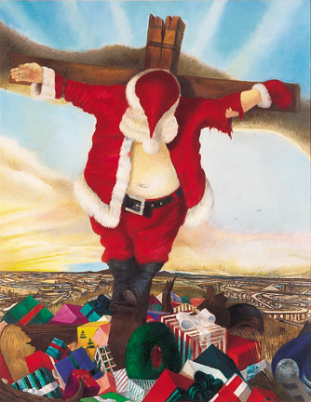
Icons

Slide 11
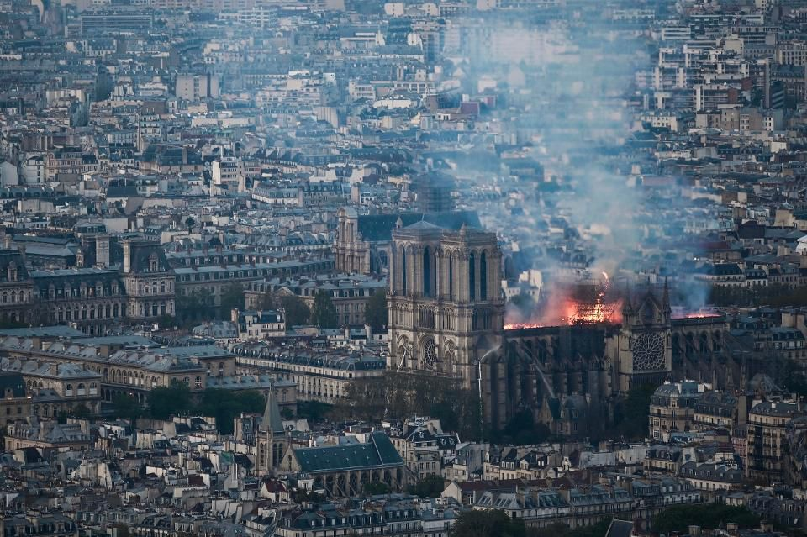
Cultural Engagement

Slide 12
Cultural Engagement: Discernment
Celebrate the positive – avoid extremes, kerygmatic filter
Speaking truth in love – liberation
Accelerator – post-modernism, fracturing of stories
Risks and abuses – determinism, agency (in but not of)
Polarization – dialogue and encounter, recovery
Human achievement – time, logic, open (other)
Discourse – skeptical, suspicion, irony, humour
Receptivity – yearning (literature, poetry, digital)
Nature – relational, reflective
Mystery – respect conscience of other

Slide 13

Points of Insertion

Slide 14
Points of Insertion
Connectivity – friendship; risk quantitative or shallow; potential blessing and profundity: only with God
Search – information; risk numbers or emotional; potential reliability, trust and helpful: truth/Truth
Sharing – gift; risk narcissism or performance; potential altruism and generosity: give oneself
Following – guidance; risk polarization or sectarianism; potential dialogue and richness: discipleship
Play – stimulation; risk distraction or isolation; potential imagination, art and beauty: wonder and awe

Slide 15

Challenge

Slide 16
Institutional Challenges
Authority – earned/conferred not claimed (celebrity)
Fora and Moderation – new authority
Networks – poly-centric
Church – richness, strategy
Laity – Lumen Gentium 31 (‘web’), feed our base
Take risks – language, young
Evaluate – learn, share
Ministerial formation – human, intellectual, spiritual and pastoral

Slide 17

Conversion

Slide 18
Conversion
Witness/Authenticity – Encounter with Christ
Who do you say that I am? – genuine and coherent
Savouring the Word (lectio divina) – actio segue esse
Silence and Solitude – listening, attention
Turning other cheek
Trust – professional and graced, no complacency yet ….
Faith – mustard seed/yeast

